Slide 1
FallArm project
CS551 - Mobile Computing for Android Mobile Devices
Instructor: Prof. Henry Chang Presented by:
Dawit Woldemichael - 19819
Linh Bien - 19627
Siqi Liang - 19821
GitHub Link:https://github.com/dawit-kiros/FallArm-Project2.git

Slide 2

Table of Contents
Introduction
Design
Implementation and Technologies
Test
Enhancement Ideas
Conclusion
References

Slide 3
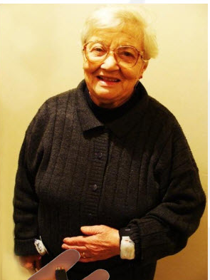
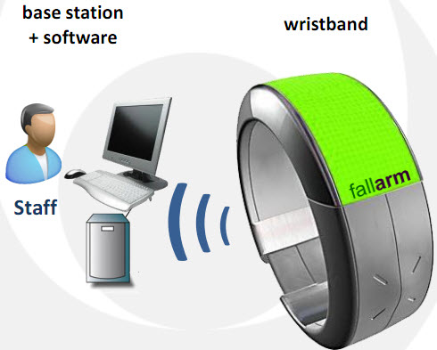
Introduction
This project showcases:
the development of an Android app designed to assist in locating patients.
If a patient falls, the application sends notifications to nurses for immediate assistance.

Slide 4
2. Design
Nurse/Doctor
IT Department
Patient
Client:
PC
Smartphone
==================
Get patient information
(Browser):
Raw data
Data mining
==================
Process request
Server:
PC
Tomcat
===================
Provide patient information
(Web server)
===================
Request help
Zigbee
Gateway
Special devices:
Sensor:
Gyroscope
Accelerometer
Zigbee:
RF/Radio
DSP
http
UDP
PAN
https
REST
Websec
TCP
TCP
Android devices
Sensors
Database: MySQL, NoSQL

Slide 5
2.1. Identify and Understand the Problems
Problem statement :
Accurately detect falls.
Efficient data transmission and integration between an Android device and the server were crucial.
Swiftly notify nurses.

Slide 6
2.2. Investigating Possible Solutions
Sensor Technologies:
Option 1: Using telnet
Option 2: Using the built-in sensor simulator
Option 3: Use 3rd party sensor simulator
Nurse Notification Options:
Option 1: Using Email
Option 2: Using SMS Email Address
Option 3: Direct SMS from the App
Server side scripting Language
Option 1: Java
Option 2 Python

Slide 7
2.2. Investigate Possible Solutions
Data transfer from Android Client to PC Server:
Option 1: HTTP/HTTPS with APIs:
Option 2: Socket Programming
Option 3: Message Queues
Determining Fall Down:
Option 1: Determining "Risk Class"
Option 2: Machine Learning technique (KNN)

Slide 8
3. Implementation and Technologies
The project was implemented in several steps:
Generating Sensor Data: Used Java code to read the generated accelerometer and gyroscope data using the emulator.
Location Services: Utilized Android's location services to retrieve the patient's location.
Socket Programming: Implemented socket programming to establish communication between the Android client and server using Java.

Slide 9
Implementation and Technologies… contd
Fall Detection Algorithm: By determining Risk Class. Using the three coordinates of the accelerometer to calculate G Force to find the risk class.
SMS Notification: Integrated SMS functionality to notify nurses of detected falls.
Migration to Kotlin: Converted existing Java code to Kotlin

Slide 10
Implementation…cntd
Step 1: Generate real-time Accelerometer and Gyroscope/Orientation readings (a set of 6 values) using the Android emulator.
Step 2: Ascertain the patient's position.
Step 3: Transmit the 6 of sensor readings, patient's location, and patient ID from the Android device to the designated server.
Step 4: The server analyses the sensor information to discern the nature of the movement.
Step 5: In the event of a patient's fall, prompt a nurse for intervention by dispatching a text message detailing the patient's info and location.

Slide 11
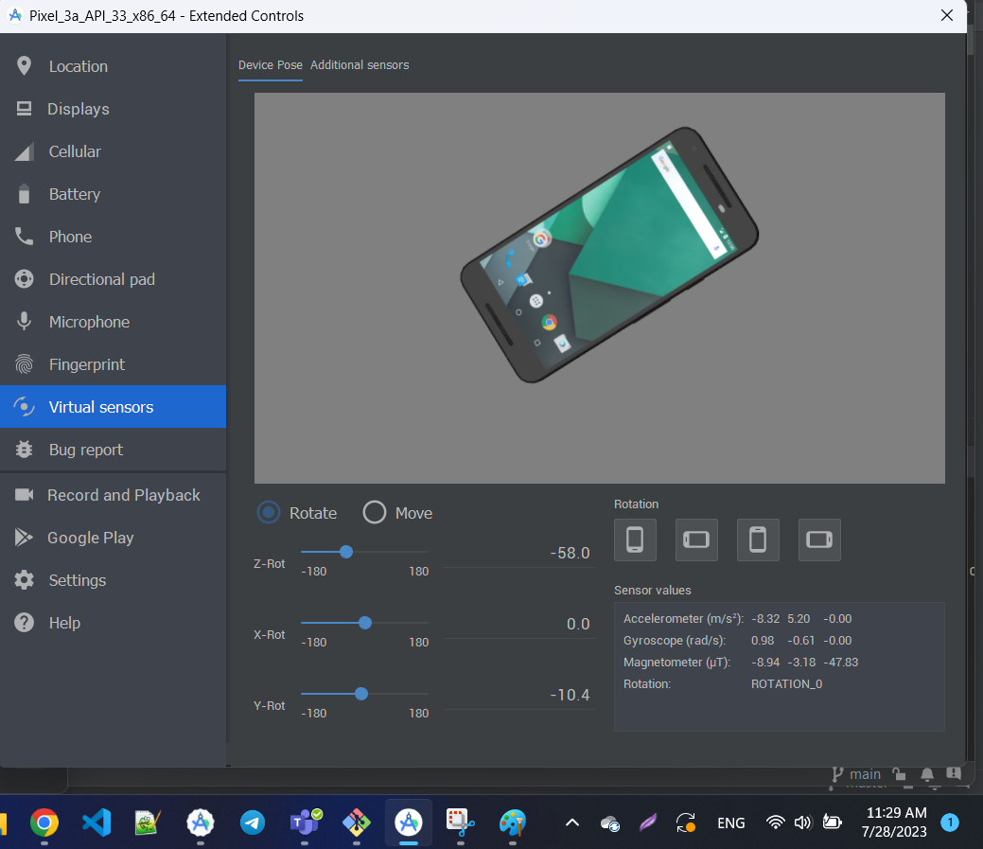
Implementation…cntd
Step 1: Generate real-time Accelerometer and Gyroscope/Orientation readings (a set of 6 values) using the Android emulator.
Used the built in sensor simulator to generate accelerometer and Gyroscope data
Structure
MainActivity.java
Activity_main.xml
AndroidManifest.xml
Link Github

Slide 12
Implementation…cntd
Step 2: Ascertain the patient's position.
Structure
MainActivity.java
Activity_main.xml
AndroidManifest.xml
Link Github

Slide 13
Implementation…cntd
Step 3: Transmit the 6 of sensor readings, patient's location, and patient ID from the Android apparatus to the designated server.
Step 4: The server analyses the sensor information to discern the nature of the movement.
Step 5: In the event of a patient's fall, prompt a nurse for intervention by dispatching a text message detailing the patient's location.
Structure
MainActivity.java
MainActivity.kt
Activity_main.xml
AndroidManifest.xml
PoolEchoServer.java
Link Github

Slide 14
4. Testing
Thorough testing was conducted at various stages:
Sensor Data Generation: Verified accurate generation of accelerometer and gyroscope data.
Location Accuracy: Ensured the correct retrieval of patient's location.
Socket Communication: Tested the data transmission between Android app and server using socket programming.
Fall Detection: Validated the fall detection algorithm effectiveness through simulated falls.
SMS Functionality: Verified SMS notifications to nurses with accurate patient location information.

Slide 15
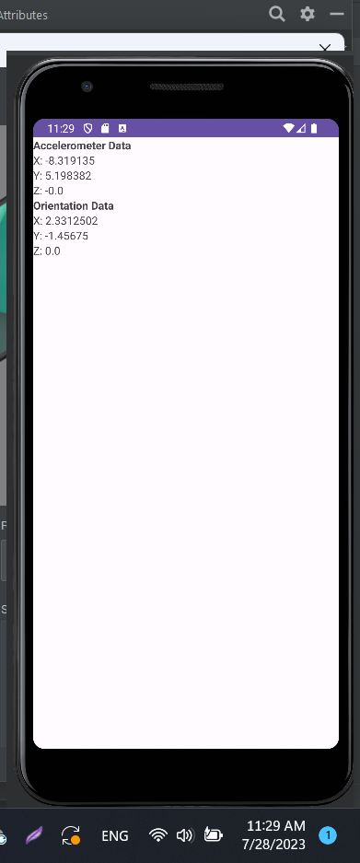
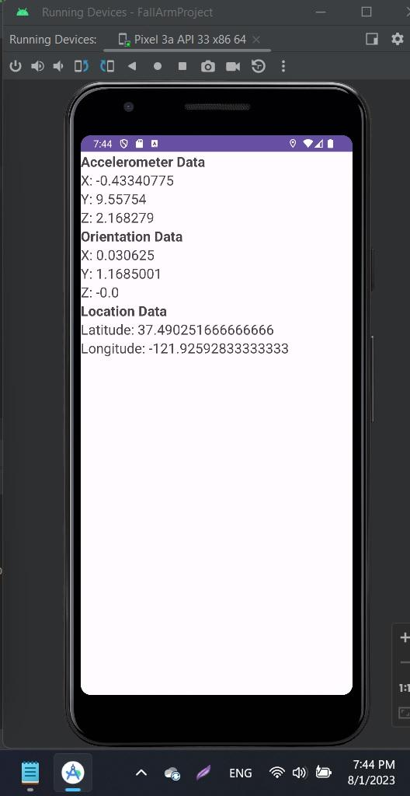
Testing …cntd

Slide 16
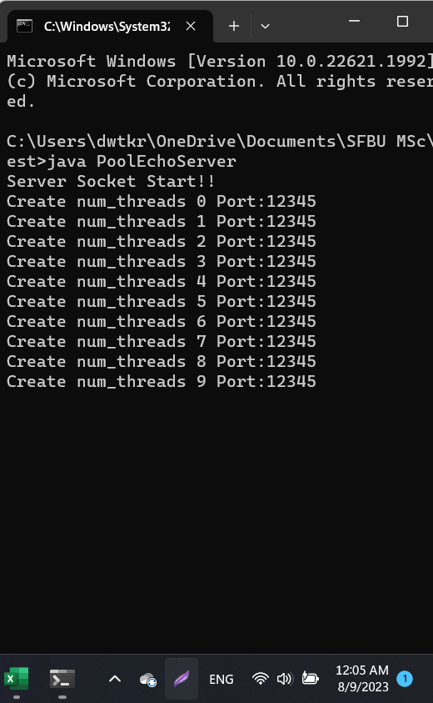
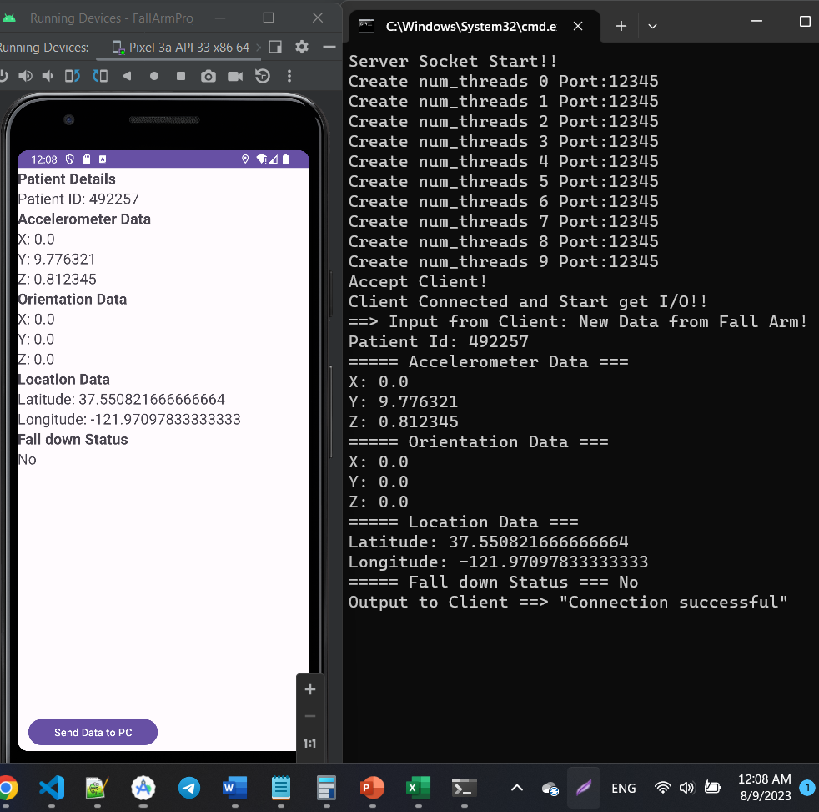
Testing …cntd

Slide 17
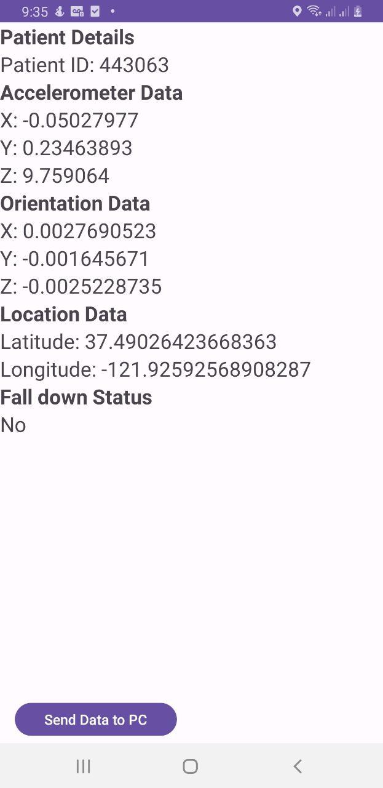
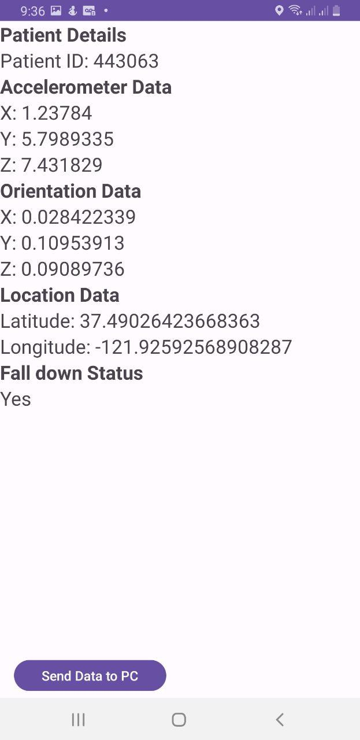
Testing …cntd

Slide 18
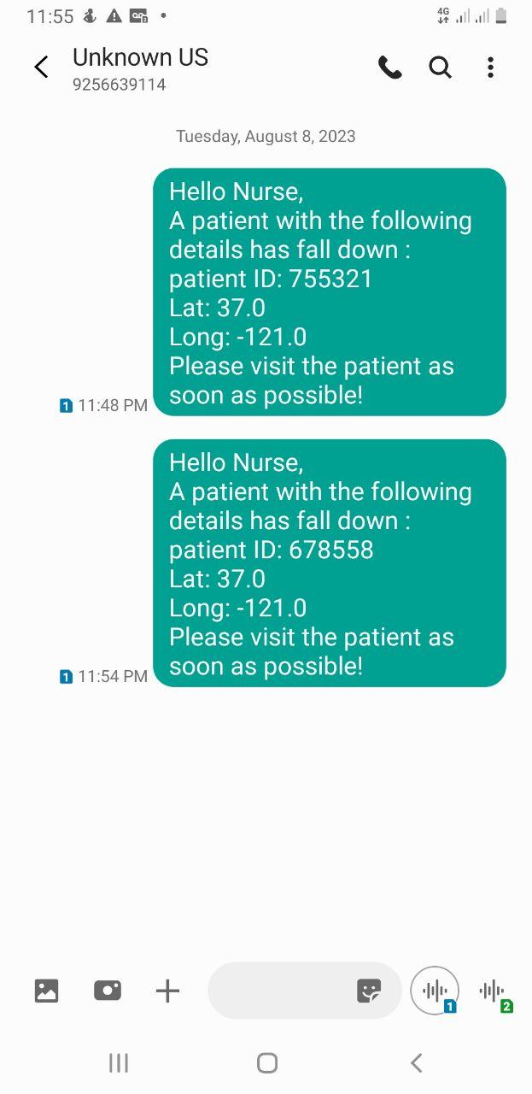
Testing …cntd

Slide 19
5. Enhancement ideas
Advanced Fall Detection
ML Integration
User Interface (UI) & Experience (UX)
Intuitive UI Design
Voice Alerts
Emergency Contacts
Auto Dial
Data Privacy & Security
Location Accuracy & Indoors Navigation

Slide 20
5.1. Advanced Fall Detection
Implementing advanced fall detection techniques can enhance the accuracy and reliability of identifying fall incidents.
Using Machine Learning
ML could be applied to various aspects, such as:
Predicting potential fall risks based on historical data,
Optimizing nurse response times, or dynamically adjusting fall detection parameters based on individual patient behavior.

Slide 21
5.2. User Interface (UI) & Experience (UX)
Enhancing the user interface design can make the FallArm app more user-friendly and accessible.
Intuitive UI Design
A clean and intuitive design with :
Clear icons,
Well-organized menus, and
Informative visuals
Voice Alerts
Voice alerts can provide an additional layer of communication :
To inform patients that a fall has been detected, reassuring them that help is on the way.,
Inform nurses that a fall has been detected

Slide 22
5.3. Emergency Contacts
Data Privacy & Security
Auto Dial
This feature can expedite the communication between the app and emergency contacts.
The app could automatically initiate a call to a pre-configured emergency contact or a designated nurse, facilitating rapid response and assistance.
To ensure that patient information is protected.
Encryption protocols for data transmission between the app and server,
Enforce strict user authentication, and adhere to relevant data protection regulations to safeguard sensitive patient data.

Slide 23
5.4. Location Accuracy & Indoors Navigation
Improving Location Accuracy
Integrating additional positioning technologies, such as:
Bluetooth beacons or
Indoor navigation systems,
Will enhance location accuracy, especially in indoor settings where GPS signals may be weak. This can help in precisely identifying the patient's location within a building or facility.

Slide 24
6. Conclusion
The FallArm project has allowed us to successfully develop an Android application for fall detection and immediate nurse notification. By integrating accelerometer and gyroscope data, location services, and socket programming, and notification services, a robust solution was achieved. The project showcases effective problem-solving, technology integration, and collaborative development.

Slide 25
7. References
https://hc.labnet.sfbu.edu/~henry/sfbu/course/capstone/android/slide/exercise_android.html#dev
https://hc.labnet.sfbu.edu/~henry/sfbu/course/capstone/android/hw/xiaolei_zhao/partialcode.pdf
https://hc.labnet.sfbu.edu/~henry/sfbu/course/android/map/slide/Updating_Locations_in_Emulator_Location_Providers.html
https://hc.labnet.sfbu.edu/~henry/sfbu/course/android/sms/slide/send_sms_by_intent.html
https://hc.labnet.sfbu.edu/~henry/sfbu/course/android/network/adam/client_server.html

Slide 26
Thank You!!!

